Slide 1

peTree : ML based pet house
Shreyash U. Ghute – 20104051
Mitali S. Chaudhari – 20104104
Sakshi V. Parab – 20104059
Project Guide
Ms. Charul Singh

Slide 2
Contents
Introduction
Objectives
Scope
Literature Survey
Proposed System
Project Outcomes
Block Diagram
Use Case/DFD
Technology Stack
Suggestions in Review-1
Result and Discussion
Conclusion and Future Scope
References

Slide 3
1. Introduction
The act of adopting an animal is a kind and selfless one that will surely bring you much love and joy.
Giving that rescue animal a second chance at life will mean the world to them. They will continue to teach you each day and make you the see the world differently.
We, tend to give these animals a new, good and healthy life by starting our website peTree.
Here, we help the people trying to adopt a pet through our site.
We would have various facilities that would lead to a good upbringing and a better life of the animal.
Veterinary Doctors would be available for the pets throughout.
For the grooming and styling of the pet, peTree too provides a commercial site that would be filled with ample amount of grooming and styling products.

Slide 4
Problems Identified in the current world that adopters face while trying to adopt a pet are….
    Different websites for pets shopping and their essentials.
    No pet training given prior adoption.
    No extra services provided by the adoption centres.

Slide 5
2. Objectives
To build an online pet house which will be user friendly.
To provide facilities of veterinarian to the customers who adopt pets from our platform.
To give training sessions to the customers who are new to adopt a pet.
To let pet lover’s search for fur babies online that they can adopt.
Best products with multiple varieties and designs and assurance of the quality.
To manage all the information about customers and their reviews/feedbacks.

Slide 6
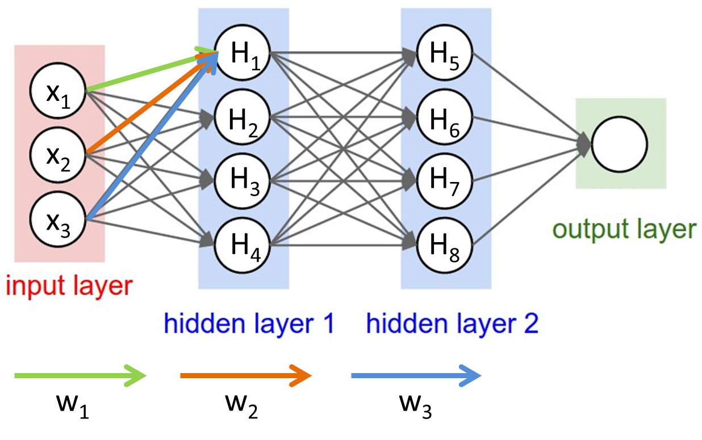
3. Algorithm Used
CNN (Convolution Neural Network):
A Convolutional Neural Network (CNN) is a type of Deep Learning neural network architecture commonly used in Computer Vision.
Computer vision is a field of Artificial Intelligence that enables a computer to understand and interpret the image or visual data.

Slide 7
3. Scope
Can be useful for potential adopters to find a pet a pet that fits their lifestyle.
Can transform pet adoption processes into an easy, fast and convenient way.
Can be helpful to the willing pet adopters who don’t find adoption centers near them.
Can become a time saving hero, being a one-stop shop for adoption as-well-as shopping.
Can become a source of employment for many people (pet trainers, Vet. Doctors, online retailers….etc.)

Slide 8
4. Literature Survey
Sr.no | Title | Author(s) | Year | Algorithms Used | Limitations | Result
1 | AI-Based Pet Adoption System | Vishwajeet Patil, Rohit Sawant, Sumit Kajbaje | April 2022 | Convolutional Neural Network (CNN), K-Nearest Neighbor (KNN) | Use of outdated technology has added some limitations to the project. | People will get an opportunity to do something for helpless animals by either adopting them.
3 | Pet Adoption App | Manan Shah, Arsh Shaikh, Zaib Shaikh | April 2021 | K-Nearest Neighbor | Only one algorithm used, whereas all other algorithms could have made it better. | Adoption of pets became easier as recommendation system helps customers to find many other pets.

Slide 9
5. Proposed System
peTree is one stop online shop for pets adoption and their products.
This platform gives the training to the parents virtually as well as physically (if requested).
Various options of selecting pets from a variety of breeds.
Parenting Test & training.
Veterinarian services & other health cares.
Pet Essentials like grooming, toys, beds, food, clothes, bowls and feeders etc.
Services like Pet Day-care ,Vaccination, etc. are provided collaborating with other websites.

Slide 10
6. Outcome of Project
User has the choice of buying various pet accessories from the shopping section.
He/she will get the Doctors appointment and the further consultations abut the healthcare of the pet.
The new adopters will get trained if don’t have any experience of having any pets.
Adopters will have a variety of services provided.
User can give feedback about the service provided etc.

Slide 11
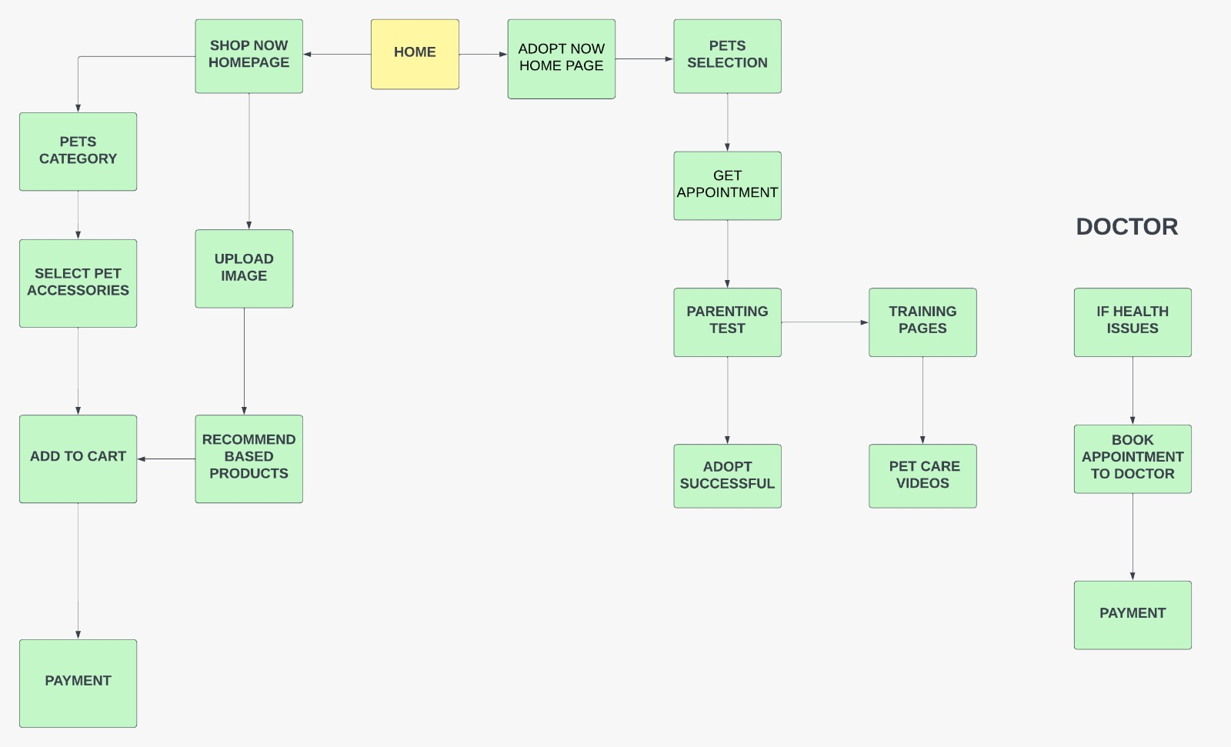
7. Block Diagram

Slide 12
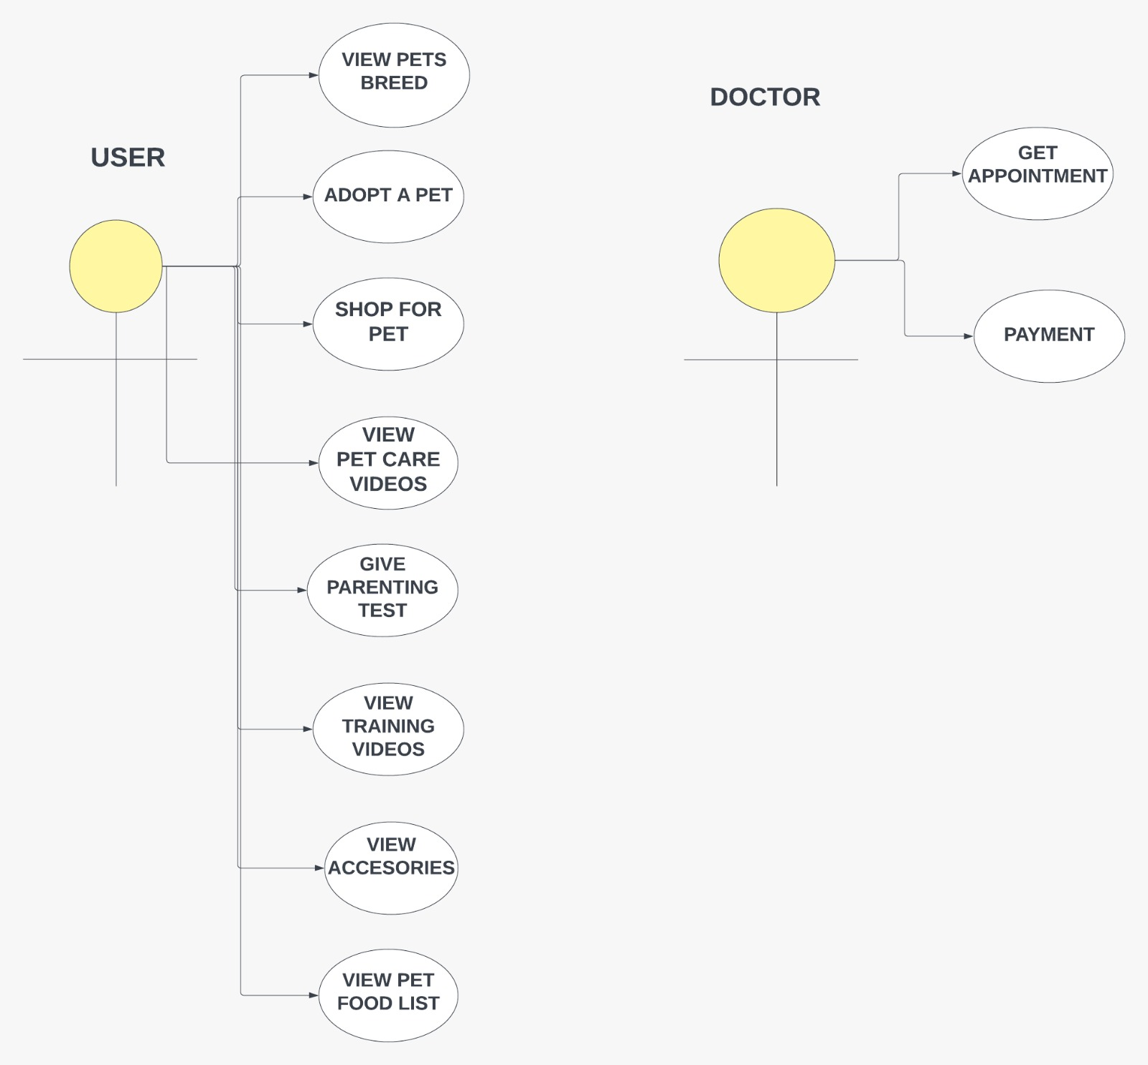
8. Use Case/Data Flow Diagram

Slide 13
9. Technology Stack
Frontend (GUI):- HTML
CSS
JAVASCRIPT
BOOTSTRAP
ML Based Algorithm Used:-
CNN [Convolution Neural Network]
Model Residual Network ( ResNet50)

Slide 14
Result and Discussion
1.Changed Block Diagram

Slide 15
2.Changed Used-Case Diagram

Slide 16
Conclusion and Future Scope
User has the choice of buying various pet accessories from the shopping section.
Using the applied algorithm, the user can find his/her required pet or the accessories by just uploading a similar image on the site.
Doctors appointment and the further consultations about the healthcare of the pet would be provided to the customer if required.
The new adopters will get trained if don’t have any experience of having any pets.
Adopters will have a variety of services provided.
User can give feedback about the service provided etc.

Slide 17
References
1. Jannete Young and Lisel O’Dwyer (2016),Mental Health of Animals.
2. Australian Institute Of Health and Welfare(2018),Follow-up survey of pet parents.
3. Kidd A. and Kidd R,(1994),Benefits and liabilities of pets for the homeless.
4. Vishwajeet Patil, Rohit Sawant, Sumit Kajbaje, Pet Adoption App.
5. Manan Shah, Arsh Shaikh, Zaib Shaikh, AI-Based Pet Adoption System

Slide 18
Thank You...!!

